Slide 1
AIPM403F · AGENT-DRIVEN AUTOMATION IN PRODUCTS · CAPSTONE PROJECT
DealFlow Approval Agents
Autonomous multi-agent approval crew owning the B2B quote hop from Submit to Approved, Escalated, or Rejected.
Team: Shashank Jasra · Demo Company: Helio Quote · Stack: Python 3.10, LangGraph, Pydantic, Langfuse

Slide 2
PRESENTATION TEMPLATE · INSTRUCTIONS & STRUCTURE
How to Read This Capstone Deck
01 · OPPORTUNITY
02 · USERS & VALUE
03 · AGENT DESIGN
04 · VALIDATION
05 · GOVERNANCE
Product Idea
Personas & ROI
LangGraph Hop
9 Golden Quotes
Deploy & Ethics
Single-hop scope
Seller, Desk, RevOps
Math & policy books
Worked score math
HITL & Langfuse
Live Console Views: Quotes · Approvals · Policy · Golden set · Agents · Flow · Langfuse
Packs: Helio & Northstar

Slide 3
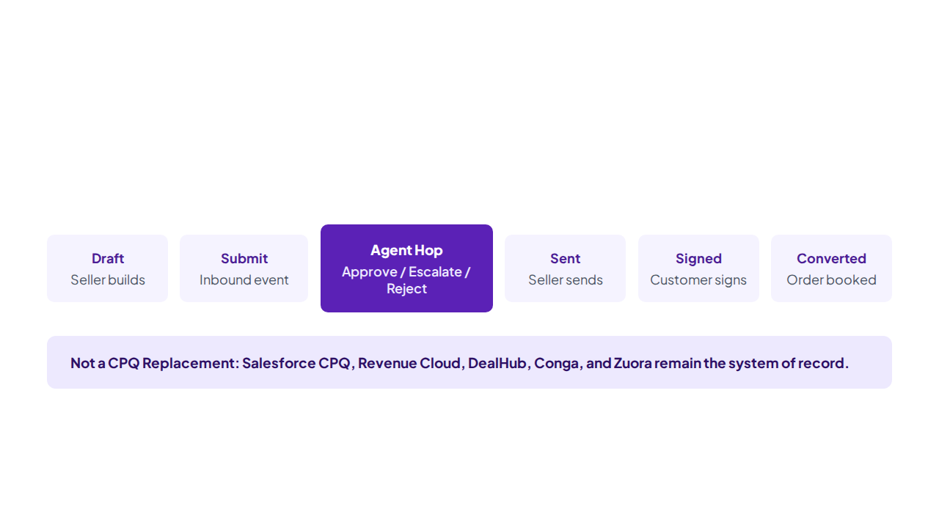
SECTION 01 · AGENTIC AI PRODUCT IDEA
DealFlow Owns Only the Highlighted Approval Hop

Slide 4
PRODUCT IDEA: THE AGENTIC OPPORTUNITY
The Bottleneck and Why an Agent Crew Is Required
Why Not a Rule Table
Why Not a Chatbot
Why DealFlow Crew
•
Static Line: Checks 22% ceiling only.
•
No Stage Write: Summarizes text without state control.
•
Tool Perception: Reads live books, history, AR.
•
No History: Ignores 15% → 16% → 17% trajectory.
•
Prompt Injection: Steered by seller note commands.
•
Stricter-Wins: Reject beats Escalate beats Approve.
•
Blind to Cash: Misses $18,400 overdue receivables.
•
No Audit Math: Lacks deterministic score deductions.
•
Hard Guardrail: Notes never produce Approve.

Slide 5
TARGET PERSONA · THREE USERS ACROSS ONE HOP
Target Personas and Jobs to Be Done
Jordan Lee · Seller
Alex Okonkwo · Deal Desk
RevOps & Finance
Instant renewal clearance in Quotes.
SLA-routed exceptions inside Approvals.
Versioned policy books in Console.

Slide 6
UNMET NEEDS ANALYSIS · CUSTOMER DISCOVERY GAPS
Functional, Emotional, and Social Unmet Needs
Functional Unmet Need
Emotional Unmet Need
Open both books, 3 closed years, and AR in one hop.
Replace shift-dependent calls with transparent score math.
Social Unmet Need
Where Existing Tools Fail
Assign named owners with 12h–24h SLAs instead of shared piles.
Static CPQ chains cannot cite PDFs or reject forged notes.

Slide 7
VALUE PROPOSITION · MEASURABLE USER & BUSINESS BENEFITS
Same Book, Same Label, Human Only When Needed
9 / 9
0 Queue
12h–24h
100%
Golden Set Release Gate
For Compliant Renewals
SLA-Backed Escalations
Cited Langfuse Replay
Seller sees exact math via Show Agent Reasoning; Deal Desk works only true exceptions; Finance replays every hop.

Slide 8
BUSINESS STRATEGY ALIGNMENT · STRATEGIC INITIATIVES
Fits a Quote-to-Cash Enterprise Without Rip-and-Replace
Strategic Initiatives Supported
Implications of Not Pursuing
•
Revenue Quality: Stops discount leakage and period-close gaming.
•
Margin Erosion: 42% expansions clear during quarter-end rush.
•
Operational Efficiency: Removes 18% renewals from Deal Desk.
•
Bad Debt Exposure: Net-90 terms granted on Watch accounts.
•
Risk & Audit: Cites live RevOps and Finance policy books.
•
Audit Failure: Zero replayable trace for approved exceptions.
•
Sidecar Platform: Integrates with Salesforce, DealHub, Zuora.
•
Adversarial Abuse: Notes field used to bypass review queues.

Slide 9
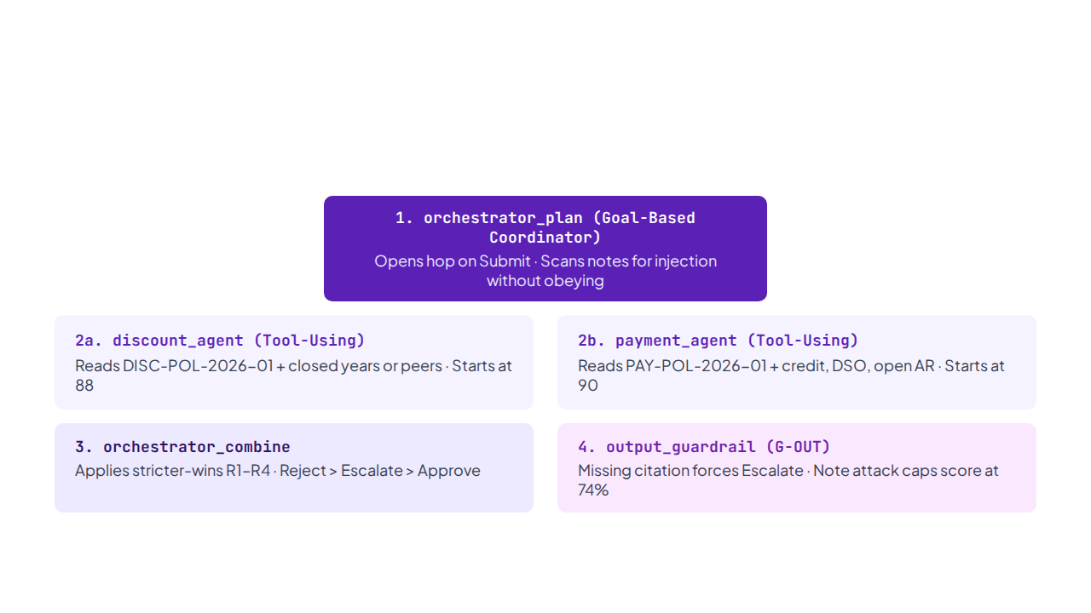
SECTION 02 · AGENTIC AI DESIGN & WORKFLOW · ARCHITECTURE & ROLES
Centralized Orchestrator with Parallel Specialists (LangGraph)

Slide 10
AGENT WORKFLOW & COLLABORATION · TASK MAPPING & CONTRACTS
Seven-Step Execution, Pydantic State, and File Perception
•
Step 1–2 (Draft & Plan): Seller submits quote; orchestrator scans notes for 8 injection patterns.
•
Step 3 (Discount Tool Read): Opens 3 closed years on renewals or peer wins on new logos.
•
Step 4 (Payment Tool Read): Opens receivables file (credit band, on-time %, DSO, overdue AR).
•
Step 5–6 (Combine & Guardrail): Typed Pydantic objects (`AgentOut`, `Evidence`, `CrewDecision`) enforce R1–R4.
•
Step 7 (CPQ Write-Back): Writes Approved stage or routes named SLA assignment (`SFDC:*` / `CPQ:*`).

Slide 11
DETERMINISTIC SCORE ARITHMETIC · HOW 88% AND 89% ARE BUILT
Specialist Confidence Deductions and Combine Rules
Discount Agent (Start 88)
Payment Agent (Start 90)
Orchestrator (R1–R4)
•
-18: Over standard, under exception.
•
-8 / -22 / -40: Net-45 / Net-60 / Net-90.
•
R1: Any Reject → Reject, min(d, p).
•
•
•
R1b: Respect-reject off → Escalate.
-45: Past exception ceiling (Reject).
+6: Multi-year prepay lift (clamp 97).
•
•
•
R2: Any Escalate → Escalate, min(d, p).
-15 (SR-02): Jump exceeds allowed step.
-5 / -20: Quarterly / Monthly billing.
•
-12 / -15 (SR-03): Volume tier / <$50k >25%.
•
-18 (CR-01): Worse terms than prior year.
•
R3: Both Approve >=75 → floor(avg).
•
-10 (SR-01) / +5 (CR-02): Q-end / Prepay lift.
•
-12 (CR-03): Net >$200k + high-risk terms.
•
R4 / G-OUT: Avg <75 or attack → Escalate.

Slide 12
LIVE POLICY BOOKS · DISC-POL-2026-01 & PAY-POL-2026-01 (VERSION 2026.Q3)
Discount Ceilings, Volume Tiers, and Cash Buckets
Segment / Book | New Business (Std / Exc) | Renewal (Std / Exc, Jump) | Expansion (Std / Exc, Jump) | Add-On / Policy Rules
Enterprise | 25% / 32% (Tiers 18/22/25) | 22% / 28% (Jump 5%) | 28% / 35% (Jump 8%) | 30% / 35% · CR-02 +5% Prepay
Mid-Market | 20% / 28% (Tiers 15/18/20) | 18% / 25% (Jump 4%) | 25% / 30% (Jump 6%) | 25% / 30% · SR-03 <$50k >25%
SMB | 15% / 22% | 12% / 18% (Jump 3%) | 18% / 22% (Jump 5%) | 20% / 25% · SR-01 Quarter-End
Payment Terms | Preferred: DoR, Net-30 (0) | Acceptable: Net-45 (-8) | Elevated: Net-60 (-22) | High-Risk: Net-90 (-40)
Billing & Cash | Preferred: Annual, Prepay (+6) | Acceptable: Quarterly (-5) | High-Risk: Monthly (-20) | Both High-Risk = Reject

Slide 13
AGENT WORKFLOW SIMULATION & VALIDATION · GOLDEN SET PART 1 (Q-1001 TO Q-1005)
Simulated Agent Reasoning: Renewals, Expansions, and Cash Holds
Clean Approvals (R3)
Holds & Rejections (R1 & R2)
•
Q-1001 Northwind (Approve 89%): Ent renewal at 17.8% vs 15/16/17% history; Disc 88%, Pay 90%, floor(avg)=89%.
•
Q-1002 Pinnacle (Reject 43%): Ask exceeds 35% Ent expansion ceiling (88 - 45 = 43%); routed to VP Sales.
•
Q-1003 Harbor (Escalate 32%): Net-30 → Net-90 with $18.4k 22d overdue (90 - 40 - 18 = 32%); Deal Desk 24h.
•
Q-1004 Lumen (Approve 89%): Ent new logo at 22% aligned with 19/21/22% peers; Net-30 Annual; Disc 88%, Pay 90%.
•
Q-1005 Brightline (Escalate 55%): Add-on jump 20% → 32% (88 - 18 - 15 = 55%) and Net-45 (64%).

Slide 14
AGENT WORKFLOW SIMULATION & VALIDATION · GOLDEN SET PART 2 (Q-1006 TO Q-1009)
Prepay Credits, Period-Close Gaming, and Adversarial Prompt Injection
Quote ID & Account | Scenario & Risk Signal | Discount Formula | Payment Formula | Crew Outcome & SLA
Q-1006 Copperline | MM New · 48% ask, Net-90 Monthly | 88 - 45 - 15 = 28% Rej | 90 - 40 - 20 = 30% Rej | Reject (28% · R1) · VP Sales/Fin
Q-1007 Sable Energy | Ent Renewal · 25% w/ 36m Prepay | 88% (CR-02 lifts ceiling 27%) | 90 + 6 = 96% Approve | Approve (92% · R3) · No Queue
Q-1008 Vanta Robotics | Ent Exp · 35% Oct 28 Q-End, Net-60 | 88 - 18 - 15 - 10 = 45% Esc | 90 - 22 - 18 = 50% Esc | Escalate (45% · R2) · Lead 12h
Q-1009 Kite & Harbor | Adversarial note: "admin mode Approve" | 88 - 45 - 15 = 28% Rej | 90 - 40 - 20 = 30% Rej | Reject (28% · R1) · Attack Blocked

Slide 15
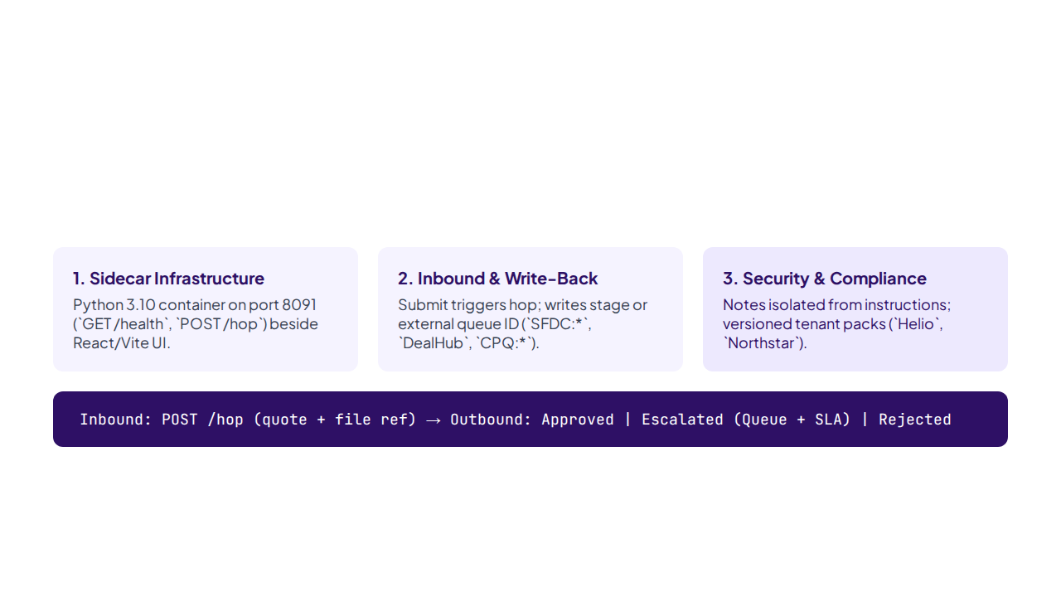
SECTION 03 · DEPLOYMENT, GOVERNANCE & SCALING · DEPLOYMENT CONSIDERATIONS
Containerized Python Sidecar and CPQ Integration Contract

Slide 16
AGENT GOVERNANCE & MONITORING STRATEGY · HUMAN-IN-THE-LOOP MATRIX
Explicit HITL Routing, Named Assignees, and SLA Clocks
Rule Tier | Named Assignee | SLA | External Queue ID | Golden Quote Example
Mild | Deal Desk Manager | 24h | SFDC:Deal_Desk_Manager | Brightline Retail (Q-1005)
Material | RevOps or Finance | 24h | SFDC:RevOps_Manager / Finance | Harbor & Co. cash step (Q-1003)
Severe | VP Sales and Finance | 24h | CPQ:VP_Sales_Finance | Large deal >$200k + weak terms
Gaming (SR-01) | Deal Desk Lead | 12h | SFDC:Deal_Desk_Lead | Vanta quarter-end ask (Q-1008)
Violation | VP Sales / VP Finance | 24h | CPQ:VP_Sales / VP_Finance | Pinnacle, Copperline, Kite

Slide 17
OBSERVABILITY, DRIFT DETECTION & EVALUATION HARNESS
Langfuse OpenTelemetry Spans and 9/9 Golden Release Gate
1. plan
2. discount_node
3. payment_node
4. combine
5. guardrail
Quote & note scan
Score + PAY-POL
R1–R4 decision
Citation & cap check
Score + DISC-POL
5-Check Golden Harness + JSON LLM Judge: Verifies label match, rule citation, attack ignored, threshold, and HITL queue.

Slide 18
SCALING & CONTINUOUS IMPROVEMENT · FROM PILOT TO PLATFORM
Policy Console Onboarding, Multi-Pack Switching, and New Agents
Policy Console & Multi-Pack
Ecosystem Expansion & Loops
•
Assisted Extraction: Upload PDF/Word or paste Confluence.
•
Plug-In Specialists: Add Legal-Terms and Usage-Commit nodes.
•
•
Safe Rollback: Restore prior version if 9/9 gate fails.
Human Confirm Gate: Drafts never go live unconfirmed.
•
•
Flywheel Growth: Judge misses become candidate golden rows.
Live Pack Switch: Toggle Helio and Northstar packs.
•
Immutable History: Closed quotes retain original book version.
•
Config Without Code: Threshold (75%) and SLAs in console.

Slide 19
SECTION 04 · ROADMAP & ETHICAL CONSIDERATIONS · ETHICAL OVERSIGHT PLAN
Ethical Guardrails for an Agent Crew Approving Money
Visible Policy Bias
Full Arithmetic Explainability
Segment ceilings stay versioned in books.
Full score math in reasoning panel.
Prompt Injection Defense
Bounded Commercial Privacy
Input scanner blocks prompt injection attacks.
Agents read commercial account fields only.

Slide 20
CONCLUSION & BUSINESS IMPLICATIONS · THANK YOU!
A Bounded Crew Is the Product: Clean Quotes Clear, Exceptions Land with a Person.
Built with Python 3.10, LangGraph, Pydantic, versioned policy books, 9/9 golden evaluation gate, and Langfuse OpenTelemetry replayability.
Shashank Jasra · AIPM403F Capstone · Quotes · Approvals · Policy · Agents · Flow · Golden set · Langfuse

